Slide 1
Goal-oriented chatbots using open-source stack
Ryszard Tuora

Slide 2
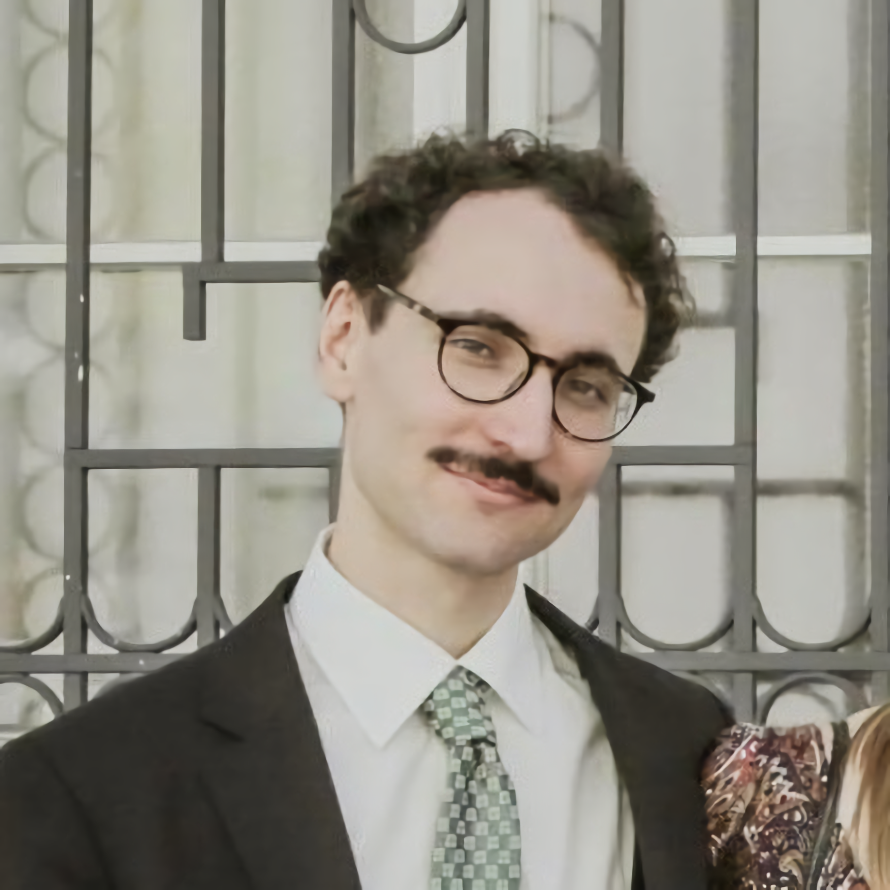
About me
Ryszard Tuora – An NLP developer working with Institute of Computer Science (Polish Academy of Sciences) and Sages.
I work on corpus processing tools, dialogue assistants and question answering systems.

Slide 3
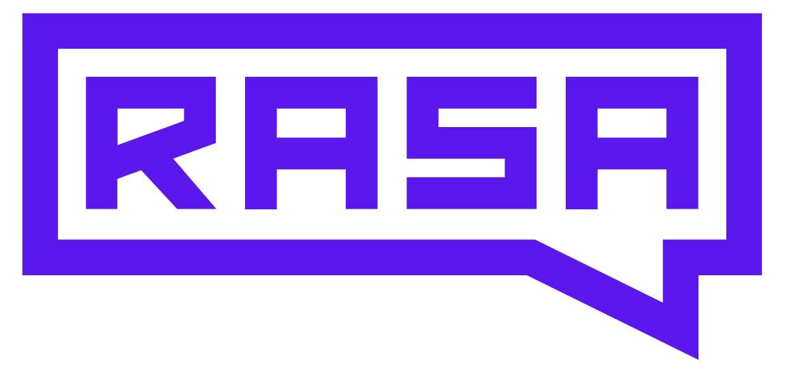
RASA
An integrated framework for building dialogue assistants.
- Open-source (Apache License 2.0)
- Python based
- Language-agnostic, easy integration with spaCy
https://rasa.com

Slide 4
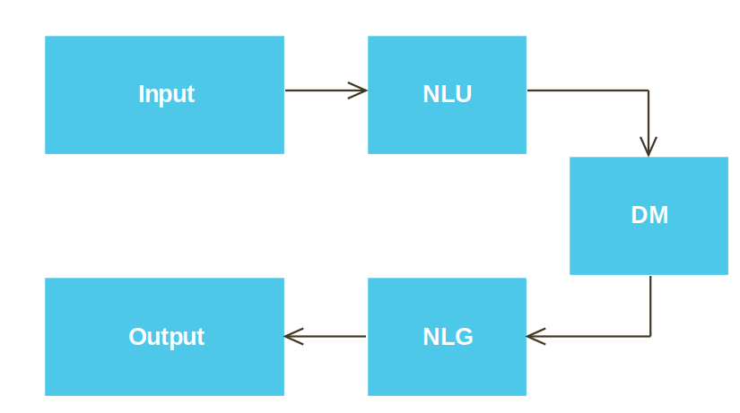
Architecture
NLU (Natural Language Understanding): converting text into an internal representation
DM (Dialogue Management): Deciding which information to remember for later, and which action to respond with, based on the context.
NLG (Natural Language Generation): Generating the natural language phrasing of the response.

Slide 5
NLU
Message: Great! I’d like to order a [large](size) [pepperoni](type).
Intent: order_pizza
Sentiment: + 0.85
size: large
type: pepperoni
Recognizing the intent behind the message (sequence classification)
Extracting the objects mentioned in the message (sequence tagging)

Slide 6
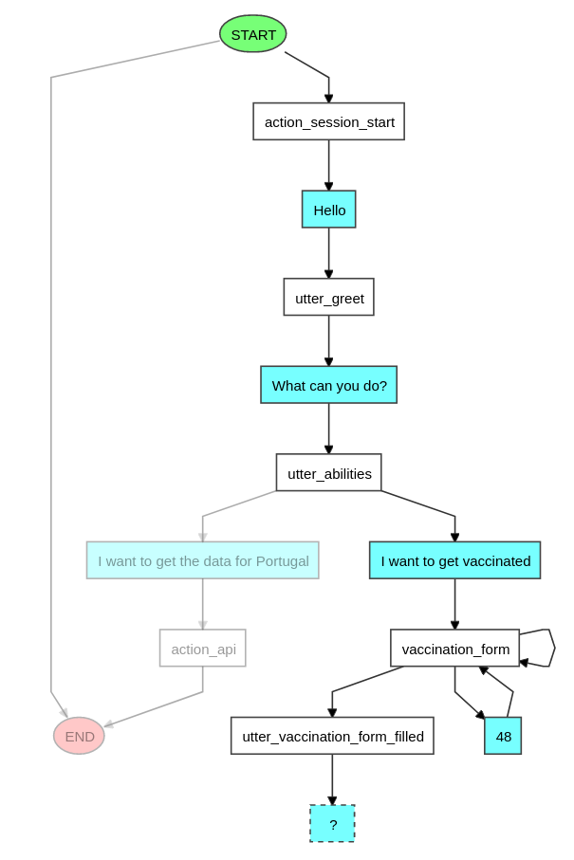
DM
Selecting the actions to be undertaken, and the information to be saved based on context
Has to be able to tackle detours, corrections etc.

Slide 7
Do you have needs concerning data analysis, machine learning or big data?
As a team of Data Scientists and Big Data specialists we are open for your needs concerning data analysis, machine learning and big data.
www.sigdelta.com

